Slide 1


TECHNOLOGY
We make the next step

Slide 2
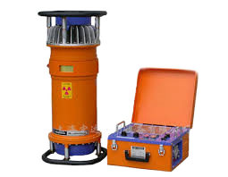
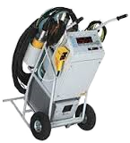
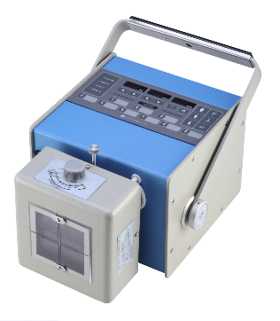
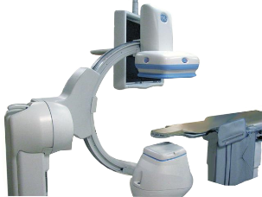
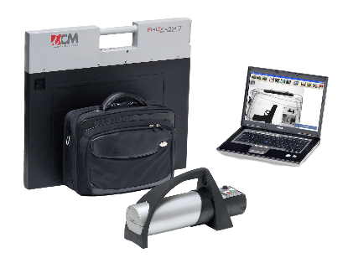
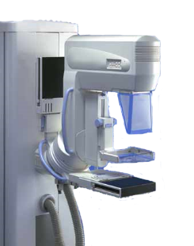
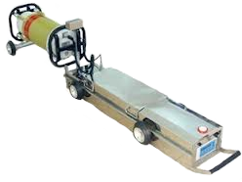
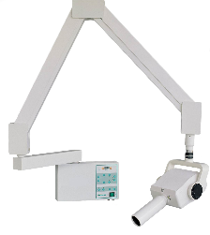
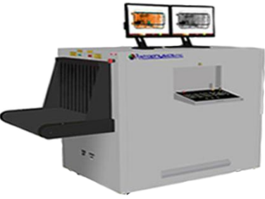
Ray
Diverse Applications

Slide 3

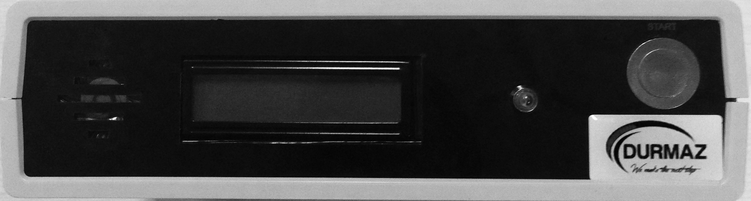

Software
Customizable.
Smart
High speed.
DICONDE based
Control
Control and synchronize varieties of modality.
Secure and reliable.
Abstract away the hardware details.
Actuator
Mountable on existing production line or
Desgin based on demands.
How Do We Solve the Problem ?

Slide 4
Modern sensation
A cell-phone is a potential NDT device!
DICONDE Based
Immortal, secure and portable data.
High tech archiving and back up.
Intelligent and Automatic
Real time intelligent decision making.
Learn from previous performance.
2D and 3D image reconstruction.
User Oriented
Customizable to best fit for the user needs.
Minimum time delay on production line.
Minimum limitation by target object dimension.
Efficient
More sensitive.
Less power.
Flexible Design
Mountable on convey belt.
Different Requirements & Architecture

Slide 5
Application High level reguirements
Middleware & Firmeware Graphic processing & control flow reguirements
Control Hardwares Dedicated platform
A Novel Approach

Slide 6
GUI
Image viewer
Image Proc.
A.I.
Logging
Security
Network
Control
Drivers
Monitoring
Data Base & Data Access
Application Layer

Slide 7
Control Flow
Exception Handling
Signal Processing
Firmware & Middleware

Slide 8
Isolation
Port
CCU
Port
Port
Control Hardwares

Slide 9
Parts Miss Alignment
Broken Part
Analyze Weldings
Missed Item
Cracks
Count Welds & Teeth
Electrical Contacts & Short Circuit
Abilities

Slide 10
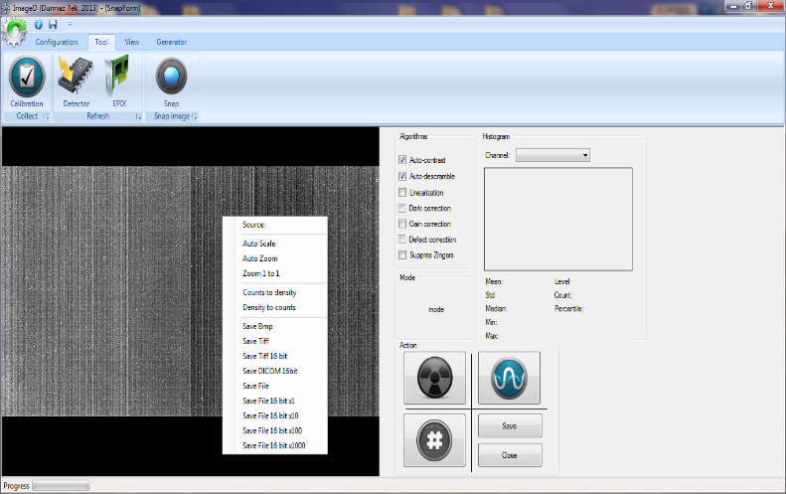
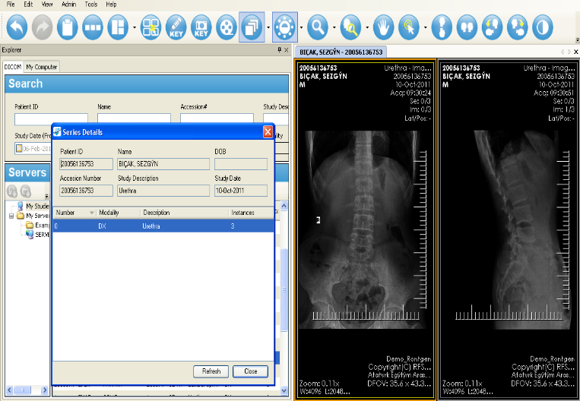
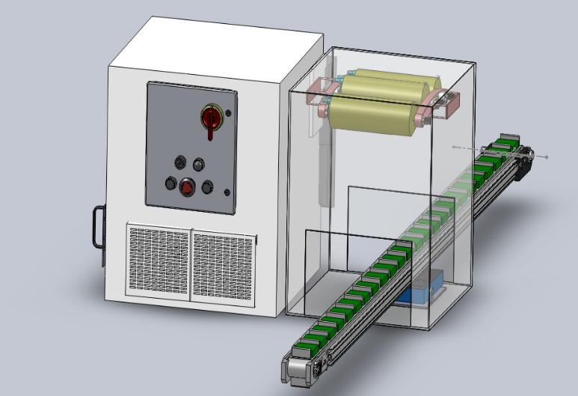
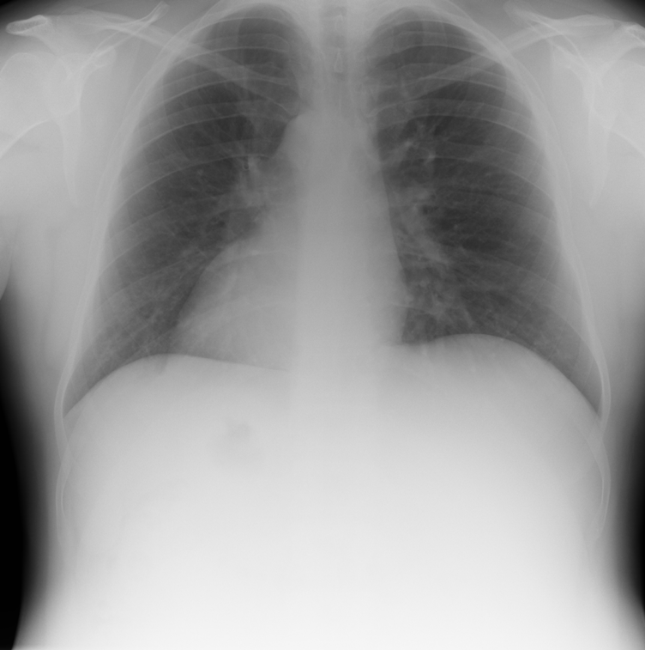
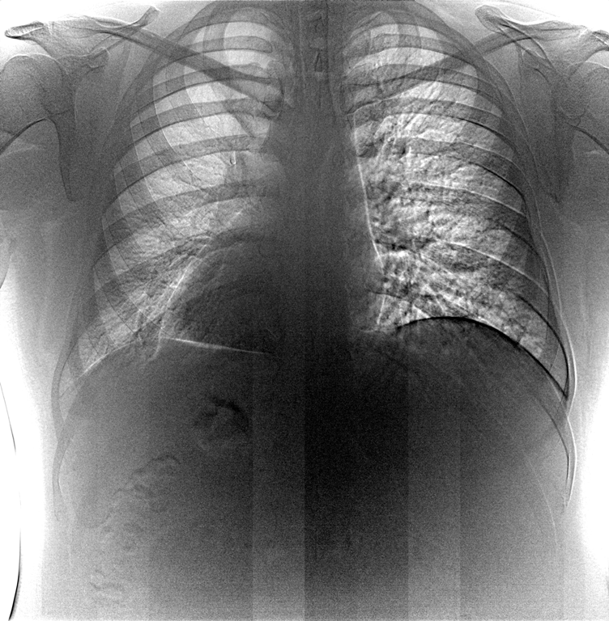
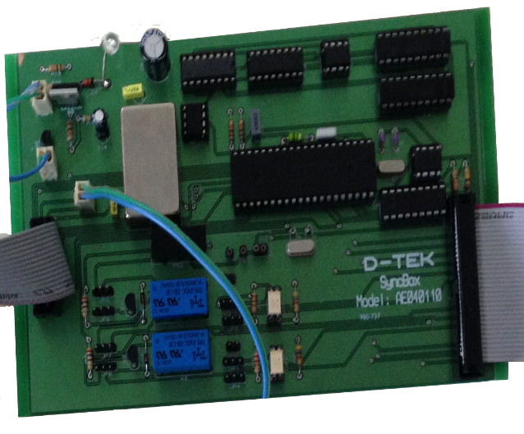
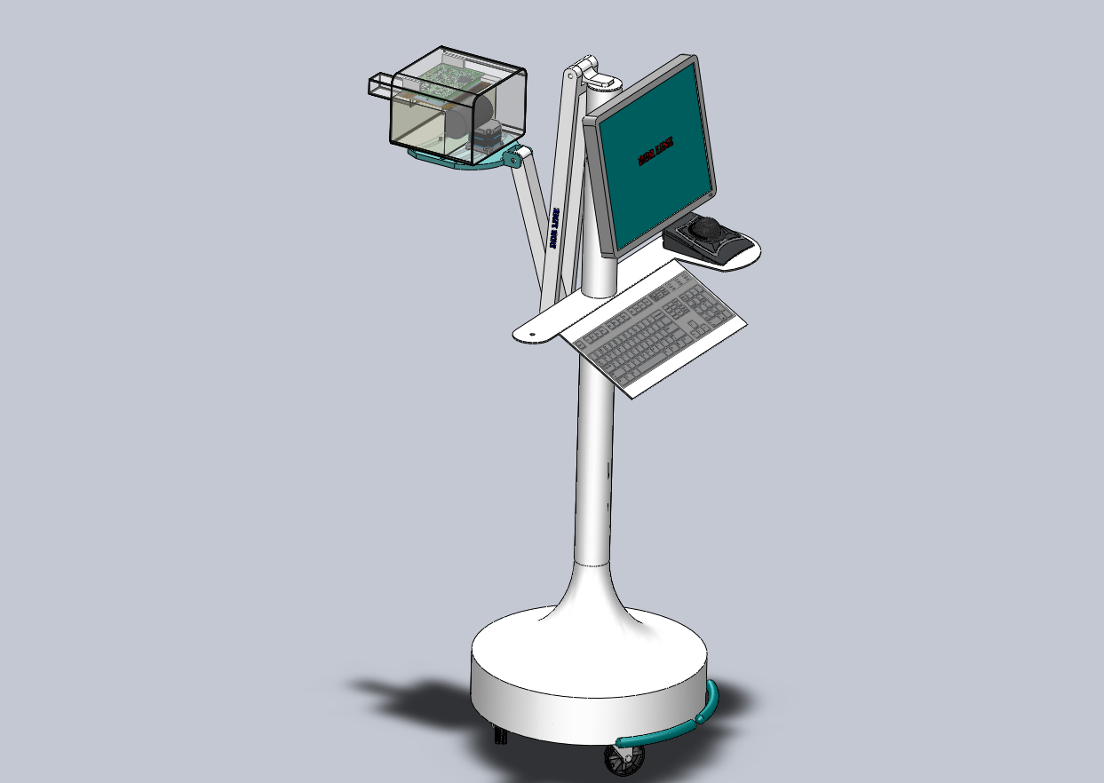
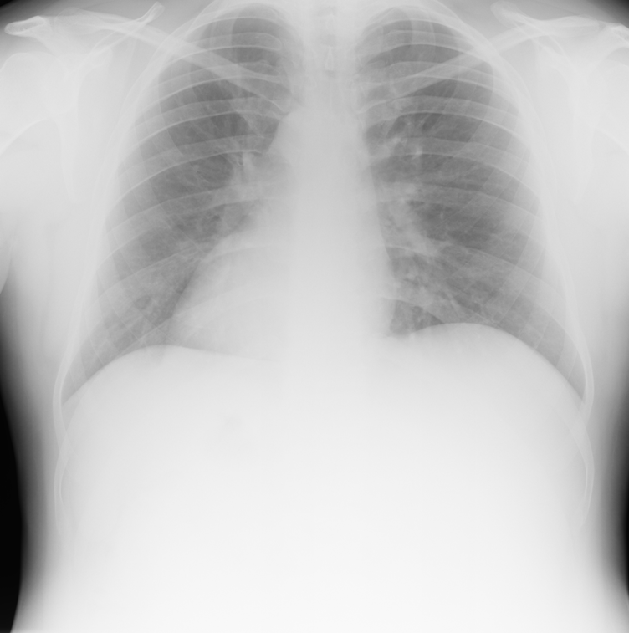
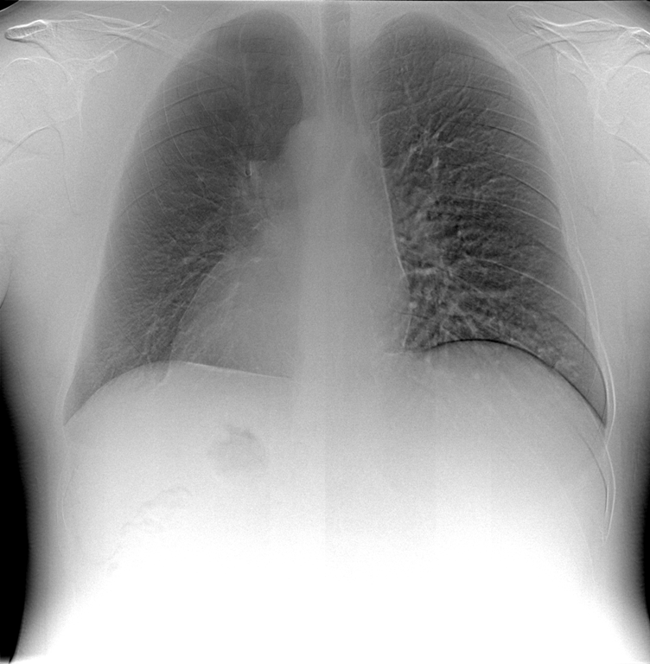
ImageD is lauched
NDT control application.
Supports:
Dexela detectors & Epix image cards
Gulmay generators.
Medical imaging platform is launched.
Based on ClearCanvas platform
NDT prototype is developed.
U-ARM Medical X-Ray.
Dual Energy.
Control platform’s prototype is tested.
Dental Xray.
2010 2011 2012 2013 2014

Slide 11
Building and Constructions
Automobile Producer
Oil-Gas
Aviation
Motor and Engine
Processed Food Lines
Customers

Slide 12
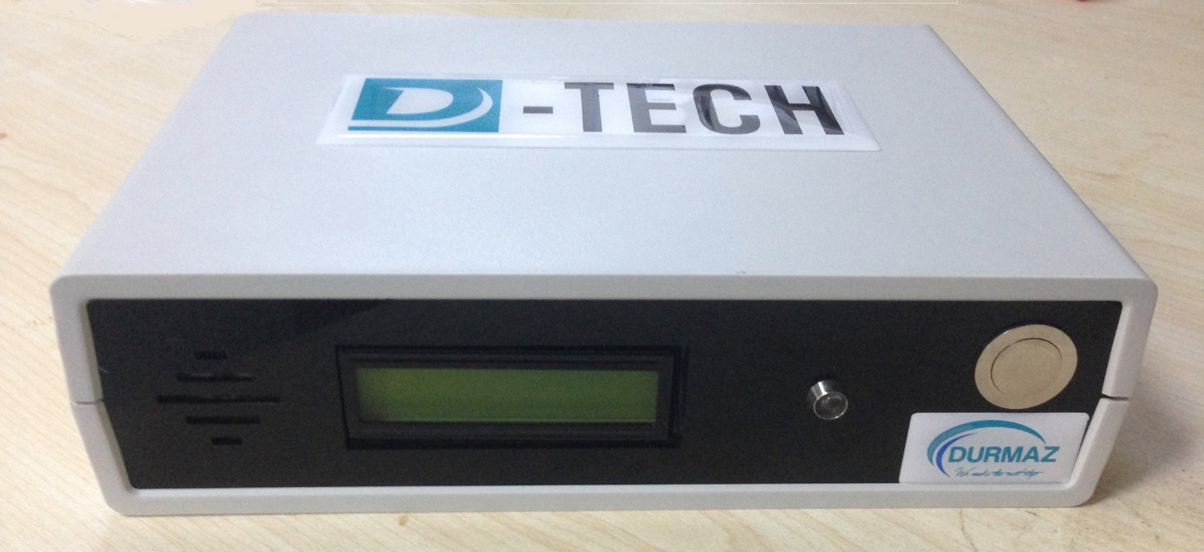
Image 1. DX-Tech SyncBox
Our Prototype

Slide 13
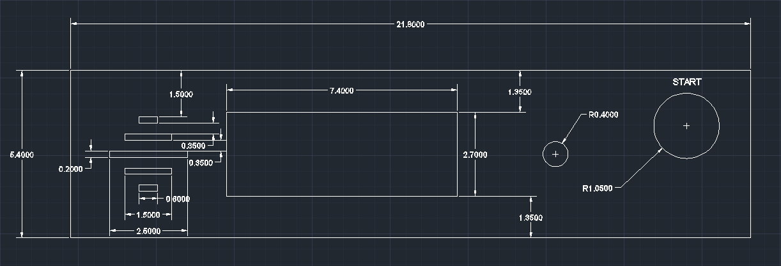
Image 2. Front Panel
Technical Drawings

Slide 14
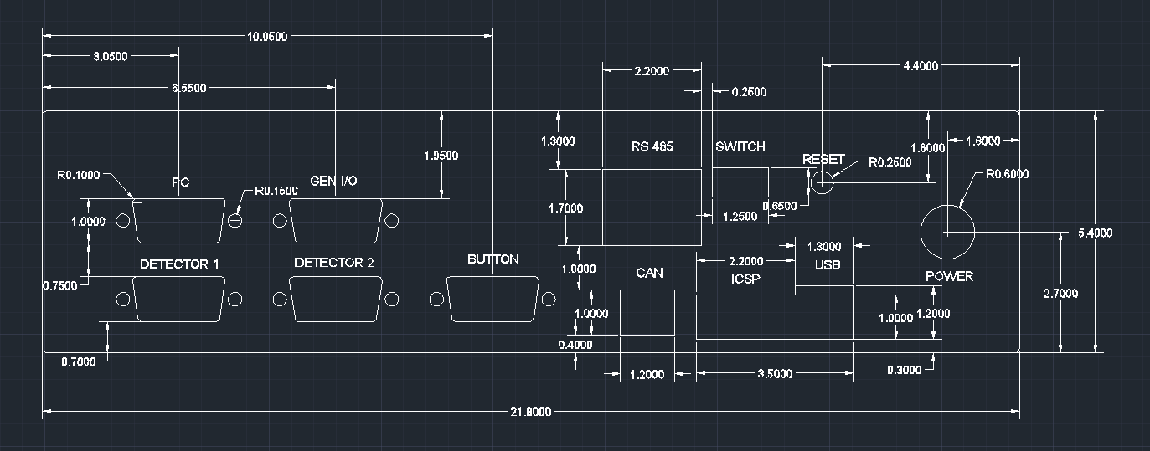
Image 3. Back Panel
Technical Drawings

Slide 15
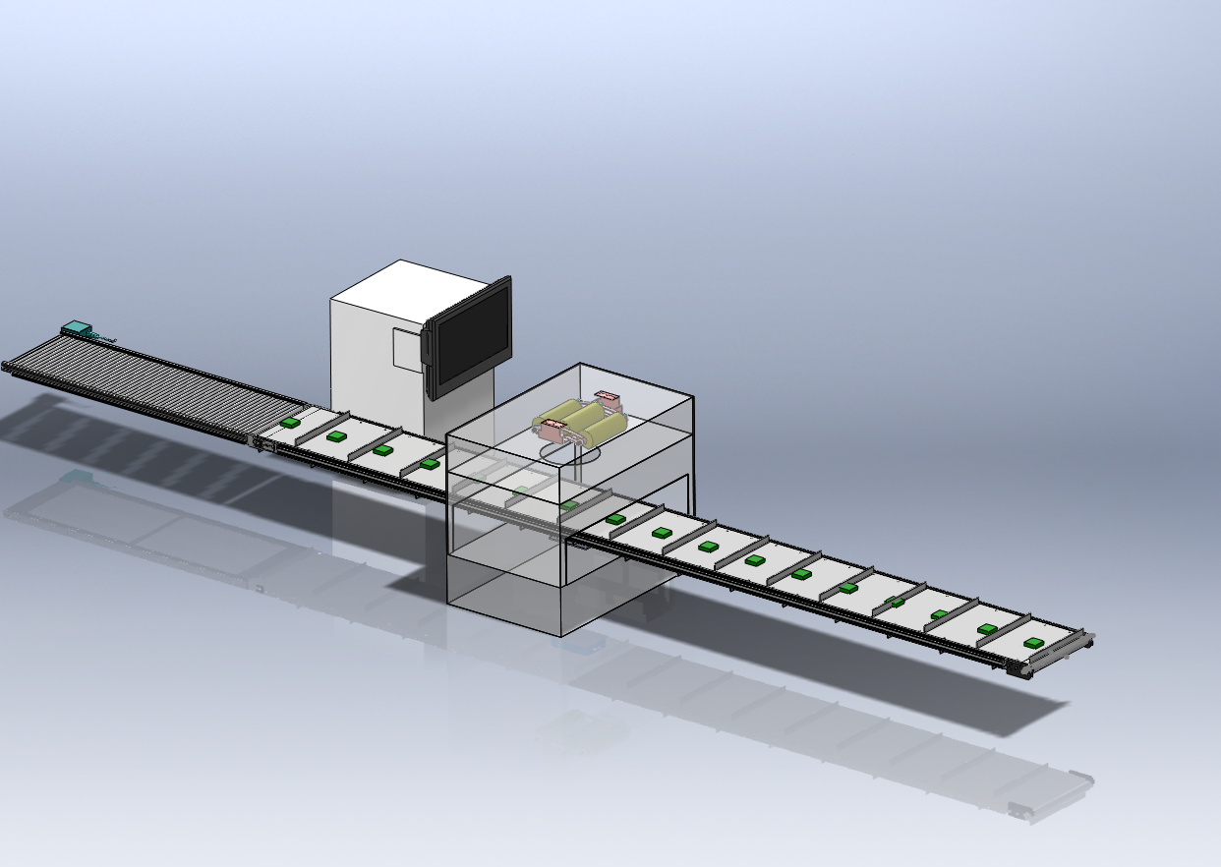
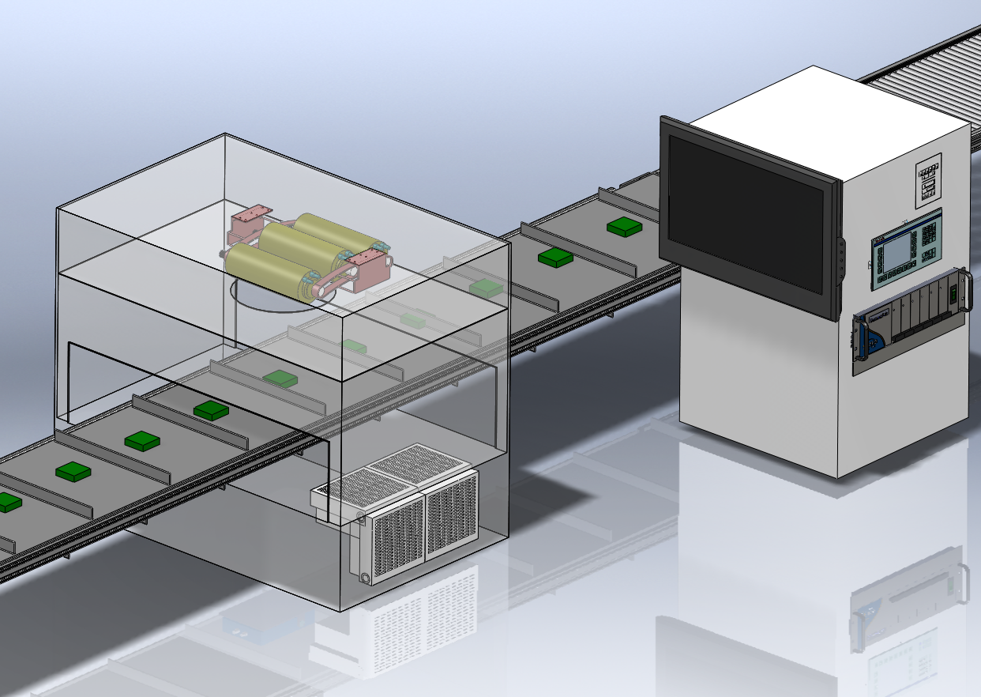
Technical Drawings

Slide 16
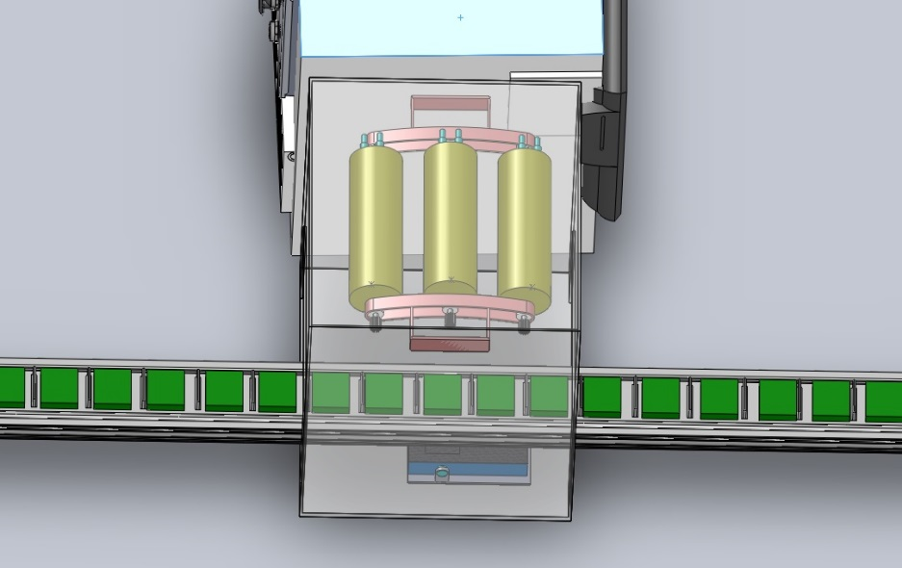
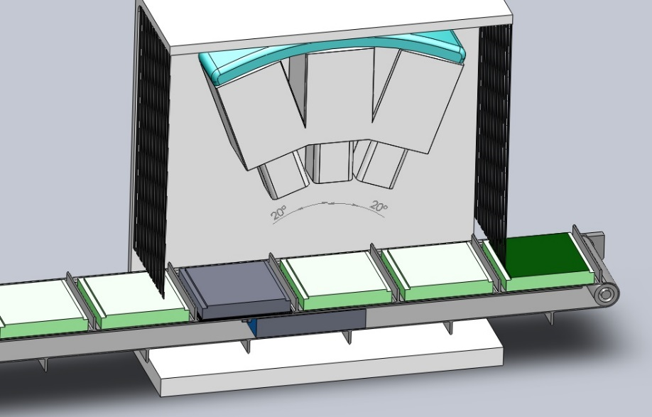
Technical Drawings

Slide 17

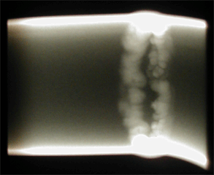
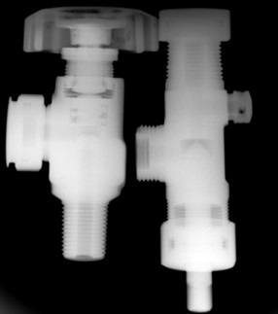
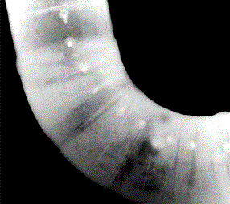
Examples

Slide 18








We Make the Next Step

